Slide 1
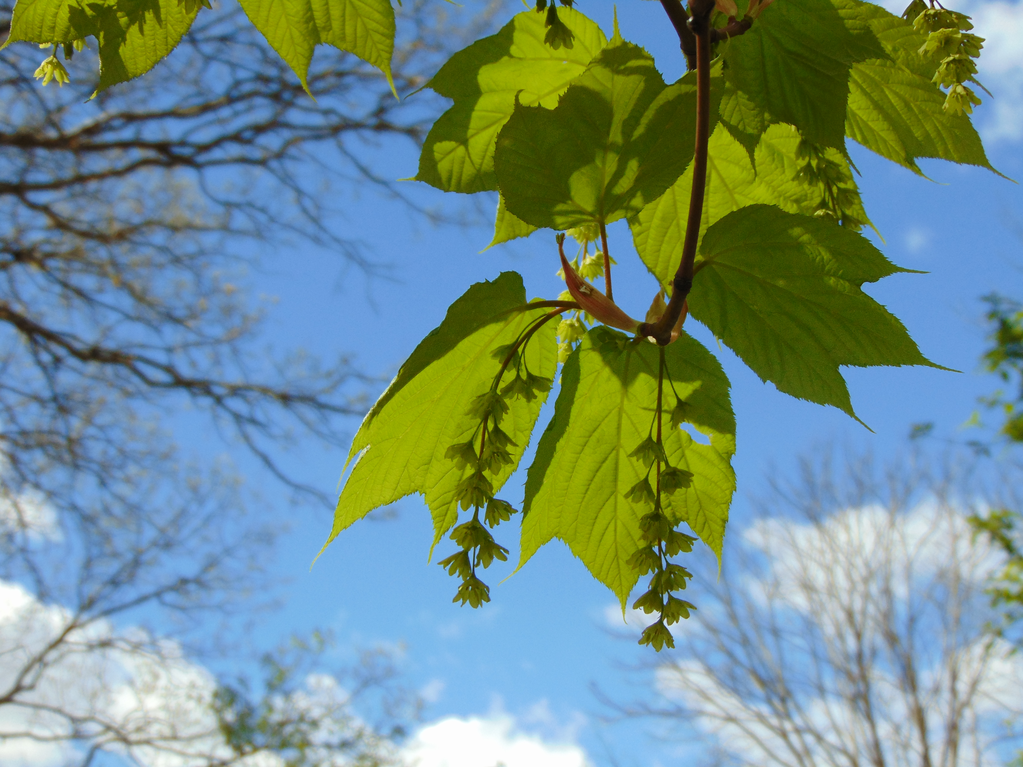
Hysteranthy Hysteria Dan Buonaiuto, September 26, 2017

Slide 2
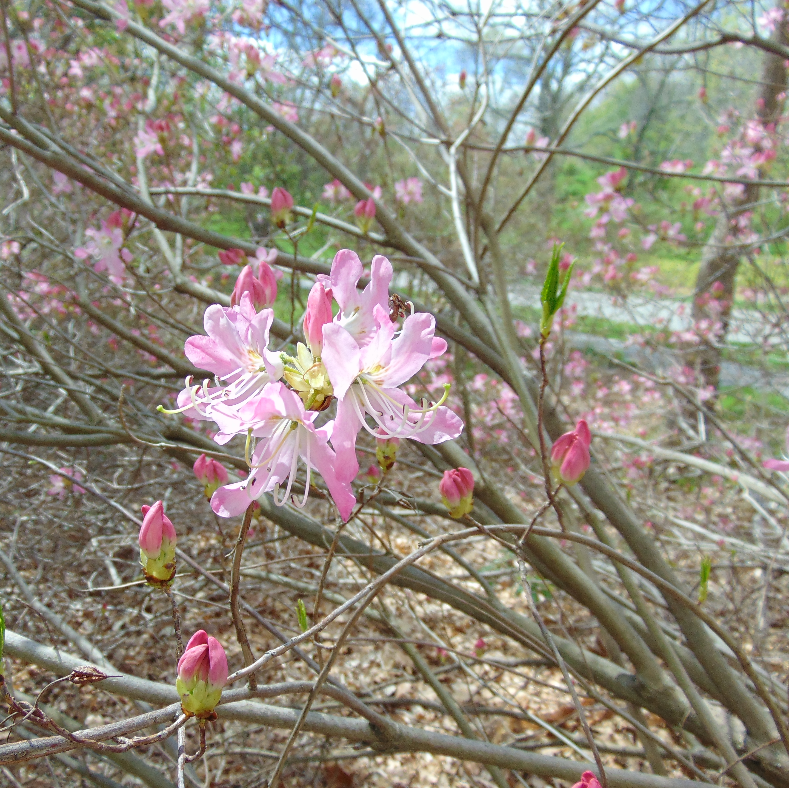
Why do some species flower before leafout, while others leafout before flowering?
To what degree are these patterns stable, especially in a changing climate space?
If patterns are flexible, what are the implications for tree reproduction and demography?

Slide 3
Wind pollination efficiency

Slide 4
Wind pollination efficiency II

Slide 5

Insect visibility

Slide 6
Differential selection
Notes:
Stabilizing selection, stronger on leaf out

Slide 7
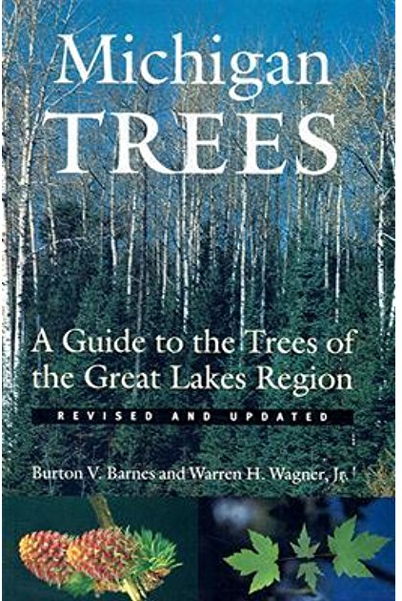
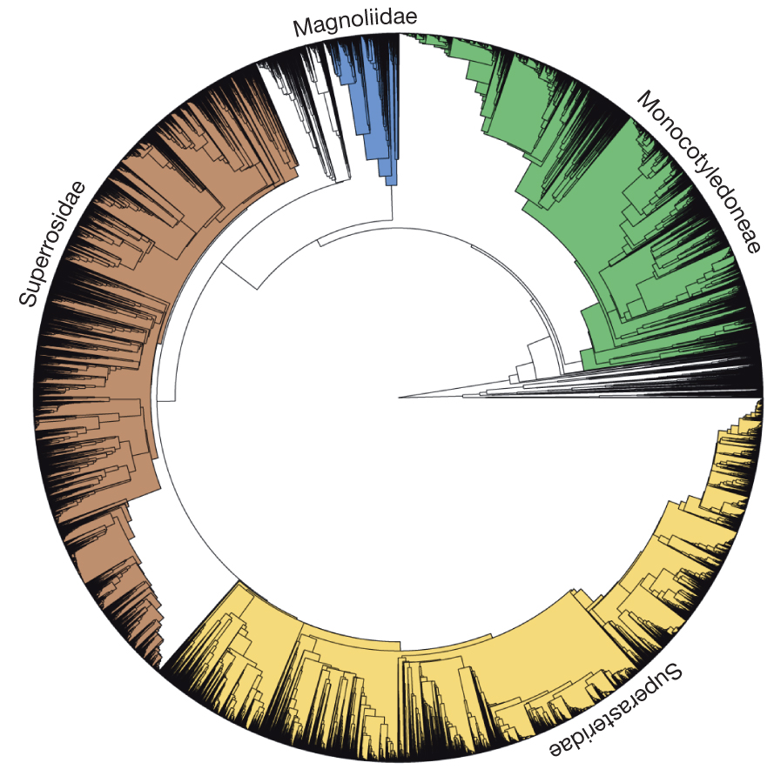
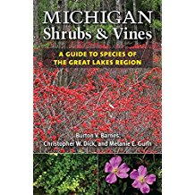
Data:
Phylogenetic Tree:
From: AE Zanne et al. Nature 000, 1-4 (2013) doi:10.1038/nature12872
Model:
Pr(Hyst(0,1))~β₁x₁+β₂x₂…+ε
Notes:
Accounting for phylogeny with phyloglm: Ives and Garland 2010

Slide 8
Notes:
Pollination syndrom, shade tolerance, fruiting time, flowering time, height

Slide 10

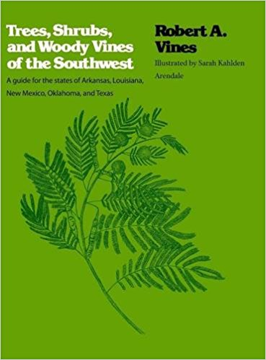
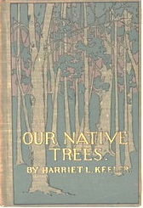
Model validation, inference space
USFS Silvics Manual:
Non-parallel data
Missing predictors
N~50, few df
In progress:
Non-parallel data
Missing predictors
N~100+ , model convergence more likely
Published 1900!
Non-parallel data
Missing predictors
N~50, few df

Slide 11
 | mod2 | mod3 | mod3a | mod4 | mod4a | mod5 | mich4cent | mod5cent
Pol | 0.238 | 0.86 | 0.16 | 0.851 | 0.91 | 0.89 | 1 | 0.86
Flo_time | -2.57 | -2.653 | -2.32 | -2.71 | -2.39 | -2.37 | -12.52 | -11.3
height | X | -0.052 | X | -0.049 | -0.046 | -0.045 | -1.76 | -0.66
shade | X | X | X | -0.18 | X | -0.07 | X | -1.2
fruiting | X | X | -0.23 | X | -0.25 | -0.25 | -0.76 | -0.05
 | Silv1 | Silv3 | Silv4cent
Pol | 1.48 | 0.98 | 0.26
flo_time | -3.17 | -3.26 | -10
av_fruit_time | X | 0.08 | X
fruiting | X |  | -3.69
height_cent | X | X | -0.51
 | Keeler2 | Keeler3(cent
Pol | 1.16 | 1.89
flo_time | -4.16 | -21.5
height |  | -0.67
Notes:
Centered by deviding by the column mean.

Slide 12
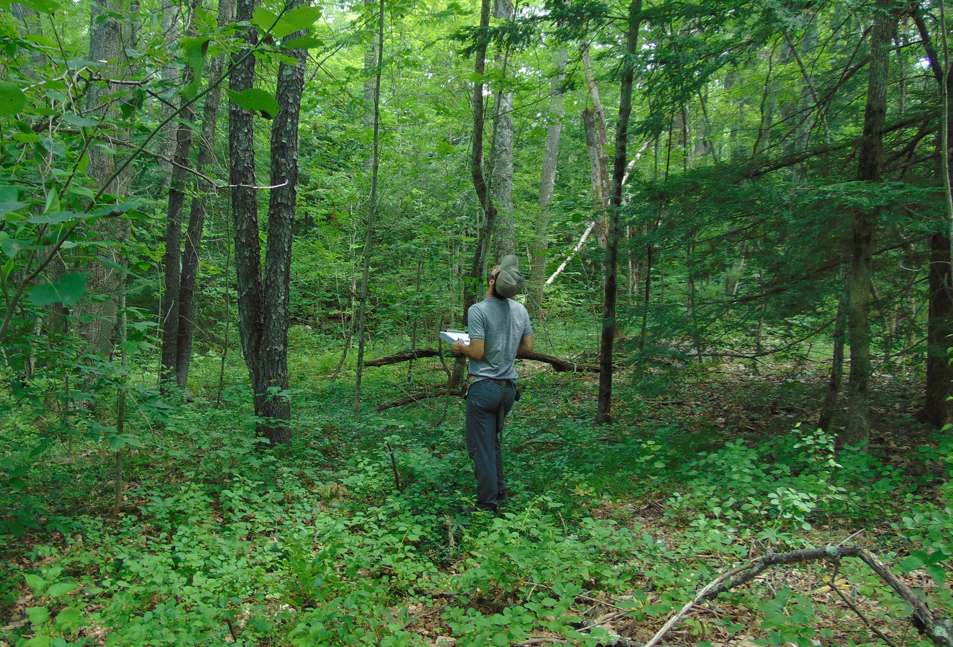
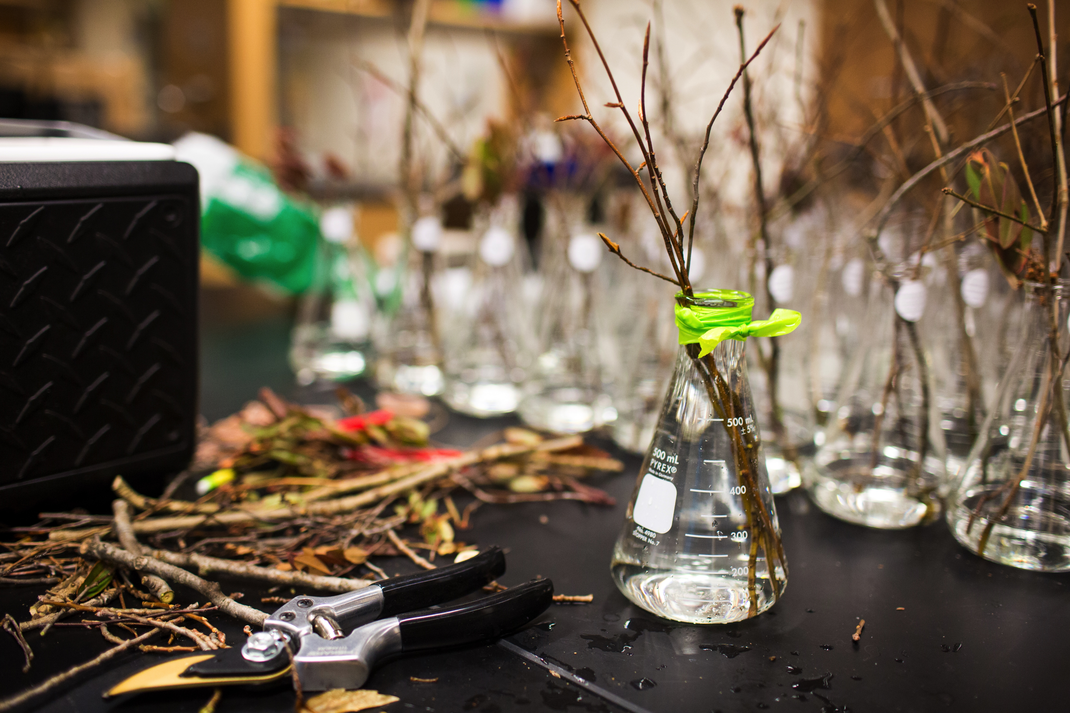
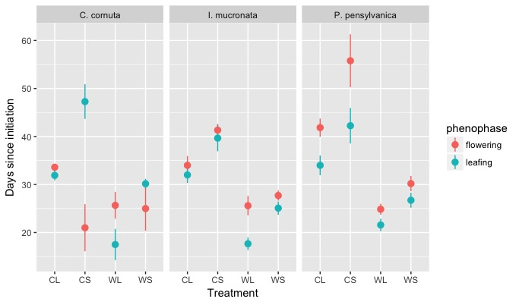
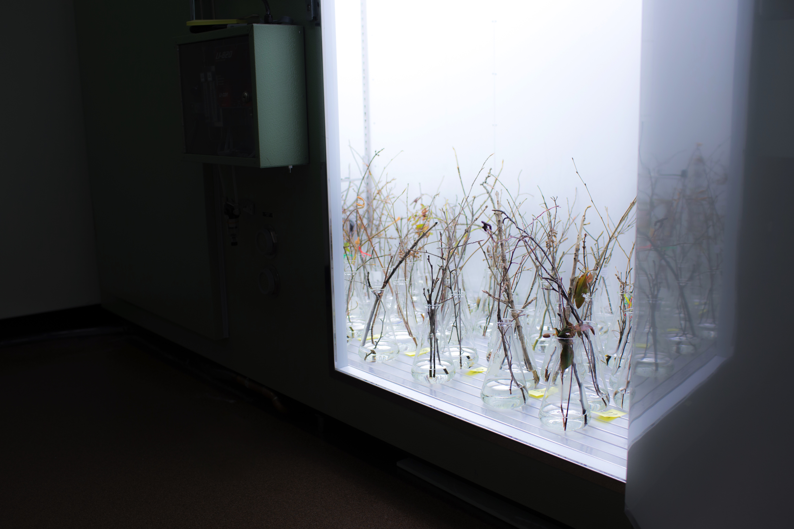
Part II: To what degree are these patterns stable, especially in a changing climate space?
Notes:
Do flowering and leafing phenologies exhibit similar sensitive to the same environmental cues? If not, we’d expect to see changes to the the interphase duration or phenological sequence under different conditions.

Slide 13
Possible patterns
Null
1.
2.
3.

Slide 14
3.
2.
1.

Slide 15
8 treatments combinations
Temperature (10, 20)
Photoperiod (8,12)
Chiling(0, 6 weeks)
12(13) species
Corylus cornuta (H)
Betula allegheniensis (H)
Acer saccharum (H)
Acer rubrum (H)
Acer pensylvanicum (N)
Fagus grandifolia (N)
Ilex mucronata (N)
Ilex verticillata (N)
Prunus pensylvanica (N)
Prunus virginiana (N)
Comptonia perigrina (H)
Vaccinium corymbosum (N)
Viburnum acerifolium (N)
Notes:
Desire only 12, might drop, fagus too dificult to cut reproductive age trees
Would love lindera, but only found 1 clone

Slide 16
Sunday October: | Monday | Tuesday | Wed | Thur | Fri | Sat
22 | 23 Cut (HF) | 24 | 25 | 26 Place (WH) | 27 | 28
29 | 30 | 31 | 1 NOV | 2 | 3 | 4
5 | 6 Alt Cut (HF) | 7 | 8 | 9 Alt Place (WH) | 10 | 11
Notes:
Push a lab meeting? Do it at HF?

Slide 17
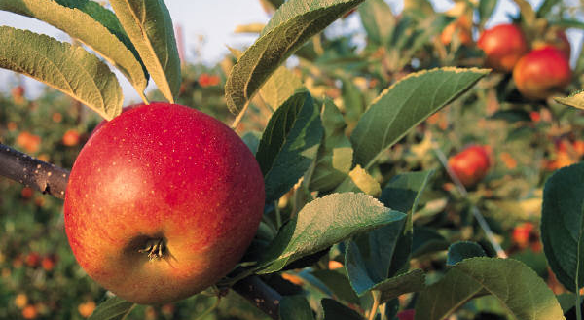
Questions, Comments, Discussion

